Slide 1



Slide 2



Slide 3




We develop intelligent and accessible technology which gives organisations the tools they need to accelerate innovation in healthcare.
Pharmly Analytics
Pharmly Cloud Data
🔗 https://analytichealth.co.uk

Slide 4



Slide 5


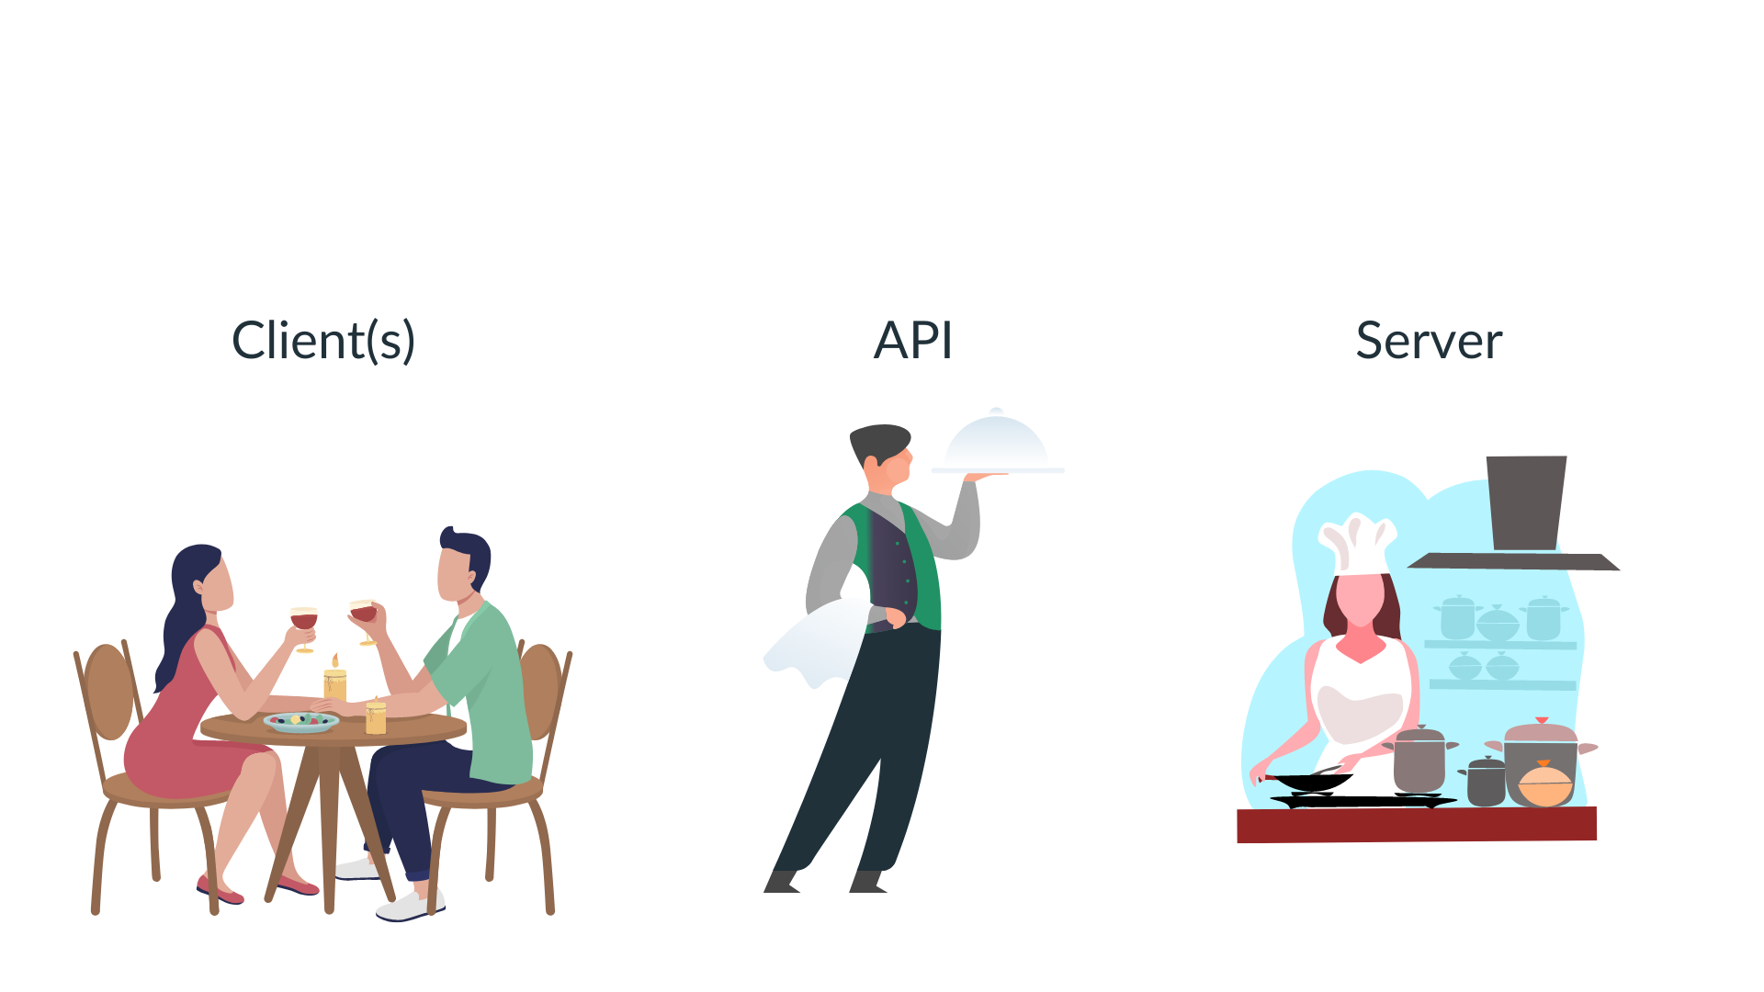
An Application Programming Interface (API) is a broad term that defines the rules that guide your interaction with some software. In the case of HTTP APIs, you have a defined set of endpoints that accept particular inputs.
Veerle van Leemput – NHS-R Community Conference 2022 © Analytic Health 2022

Slide 6
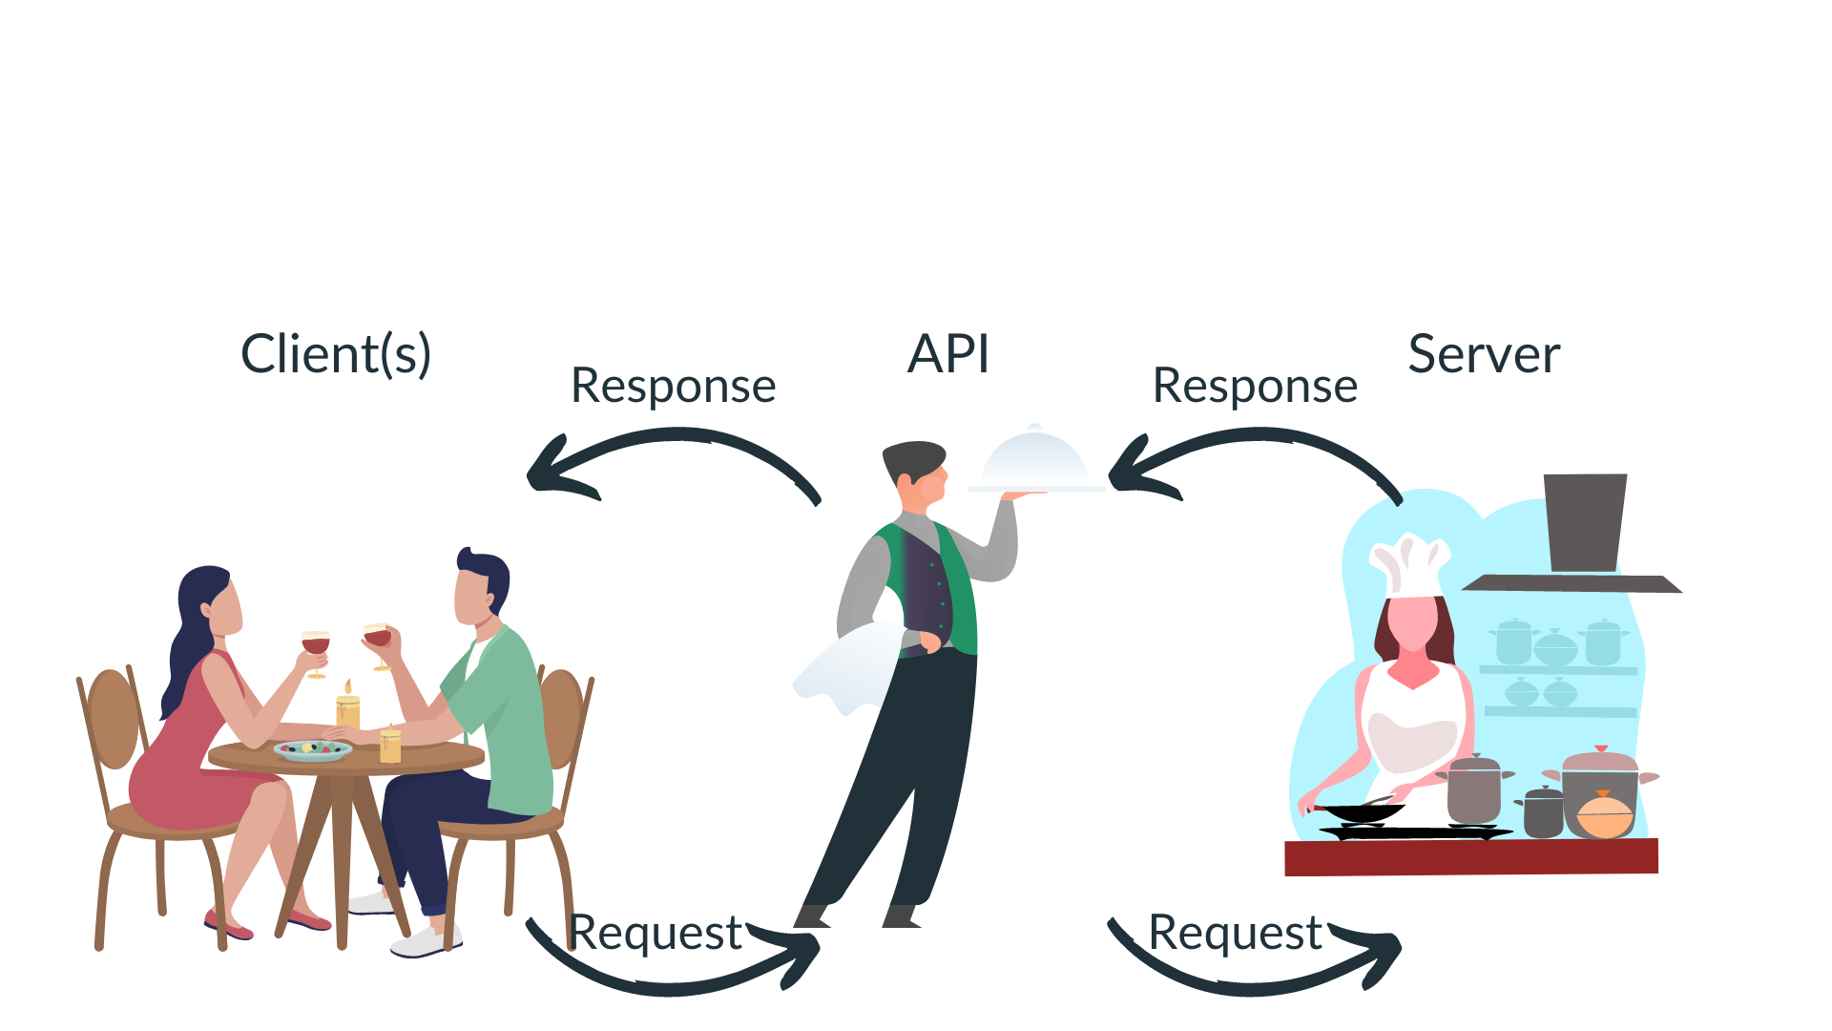
APIs accept requests and return responses. In the case of HTTP APIs, you have a defined set of endpoints that accept particular inputs.
Veerle van Leemput – NHS-R Community Conference 2022 © Analytic Health 2022

Slide 7


Imagine you’re the chef and need to serve all the food yourself…
Veerle van Leemput – NHS-R Community Conference 2022 © Analytic Health 2022

Slide 8



Slide 9

#1: Communication. An API allows connection with third parties, whether they are colleagues, clients, other providers or partners. Independent of programming language.
#2: Integration. APIs can easily integrate with existing infrastructure like legacy dashboards and databases.
#3: Efficiency. Information provided through an API is published automatically and available immediately.
Veerle van Leemput – NHS-R Community Conference 2022 © Analytic Health 2022

Slide 10
#4: Automation. Distribution of data is managed by the API. This makes it easier to create automated workflows.
#5: Customisation. Users can customise the service to their needs. They can put in their own request and manipulate the response themselves.
#6: Scalability. Seperation allows for better scaling capabilities.
Veerle van Leemput – NHS-R Community Conference 2022 © Analytic Health 2022

Slide 11



Slide 12

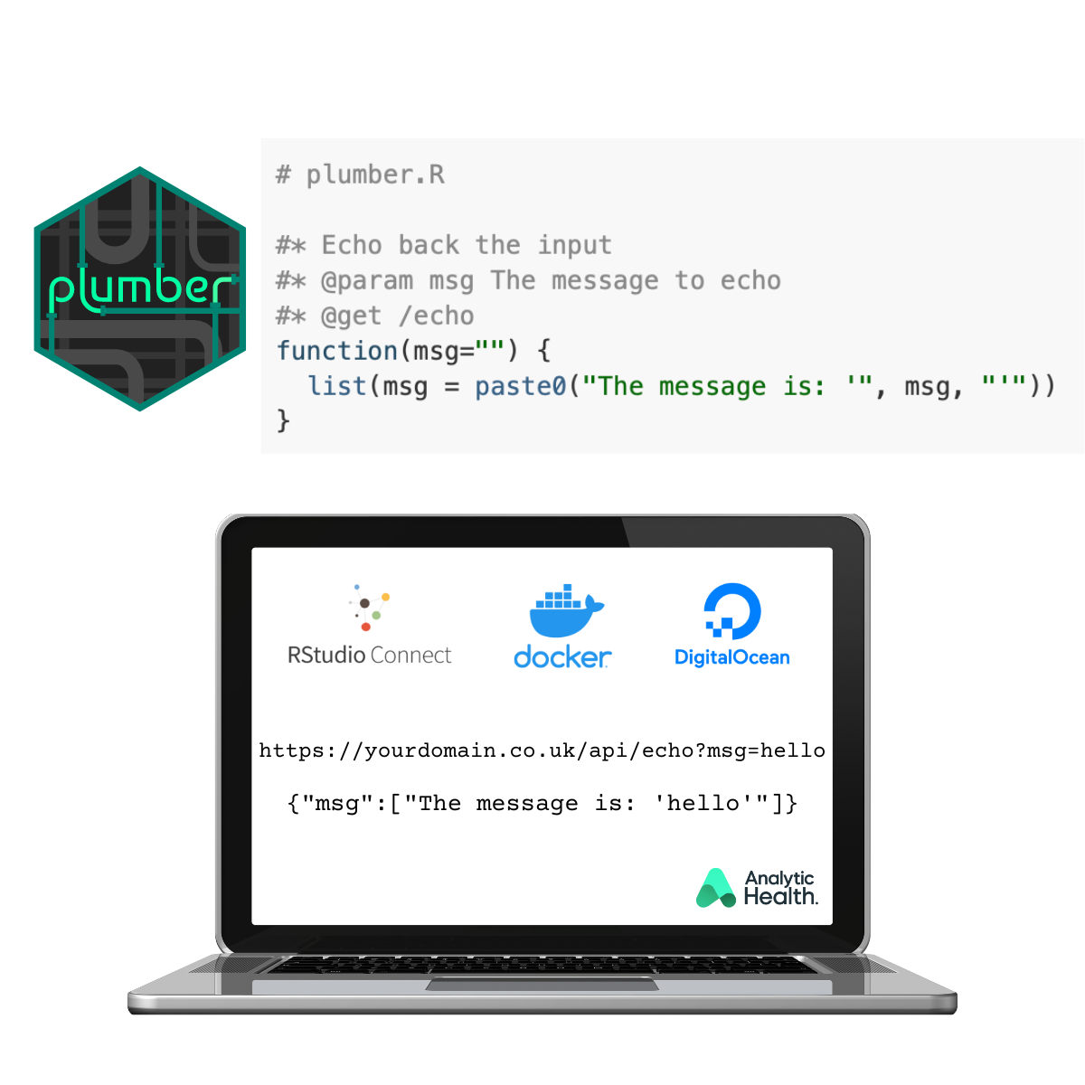
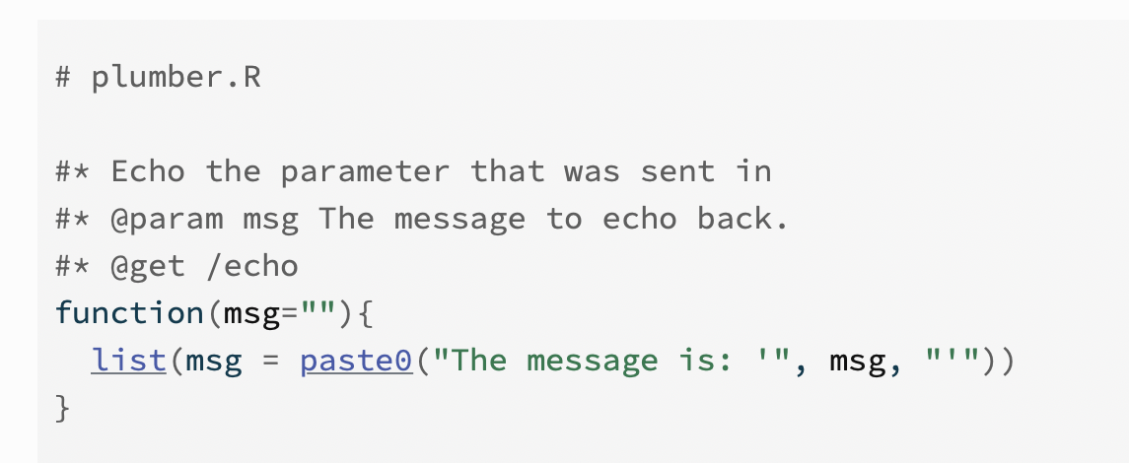
Source: https://www.rplumber.io
Veerle van Leemput – NHS-R Community Conference 2022 © Analytic Health 2022

Slide 13
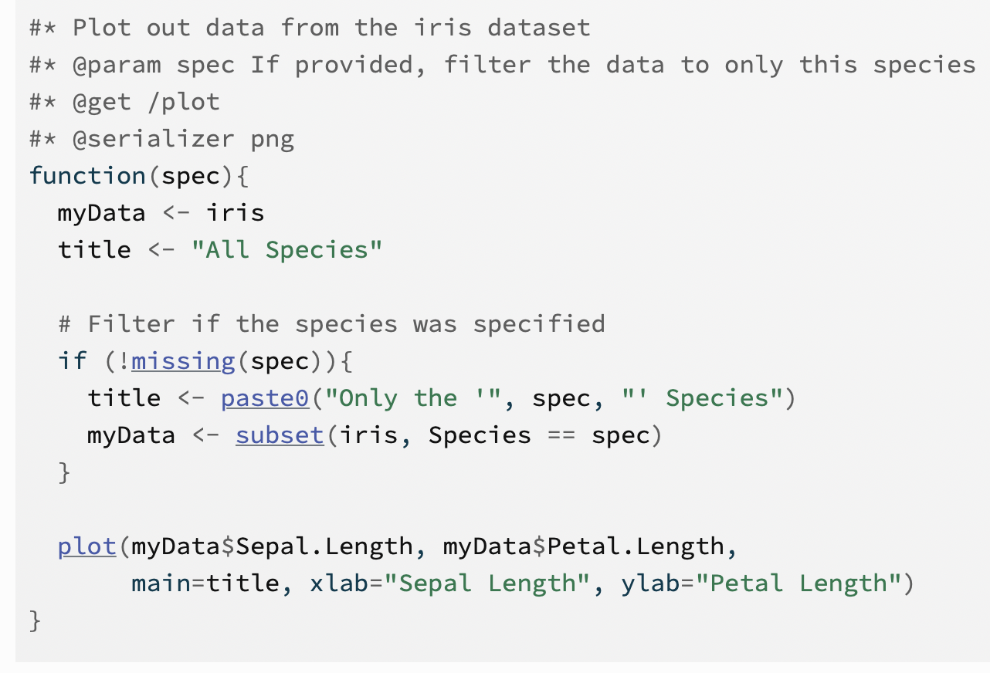
Source: https://www.rplumber.io
Veerle van Leemput – NHS-R Community Conference 2022 © Analytic Health 2022

Slide 14

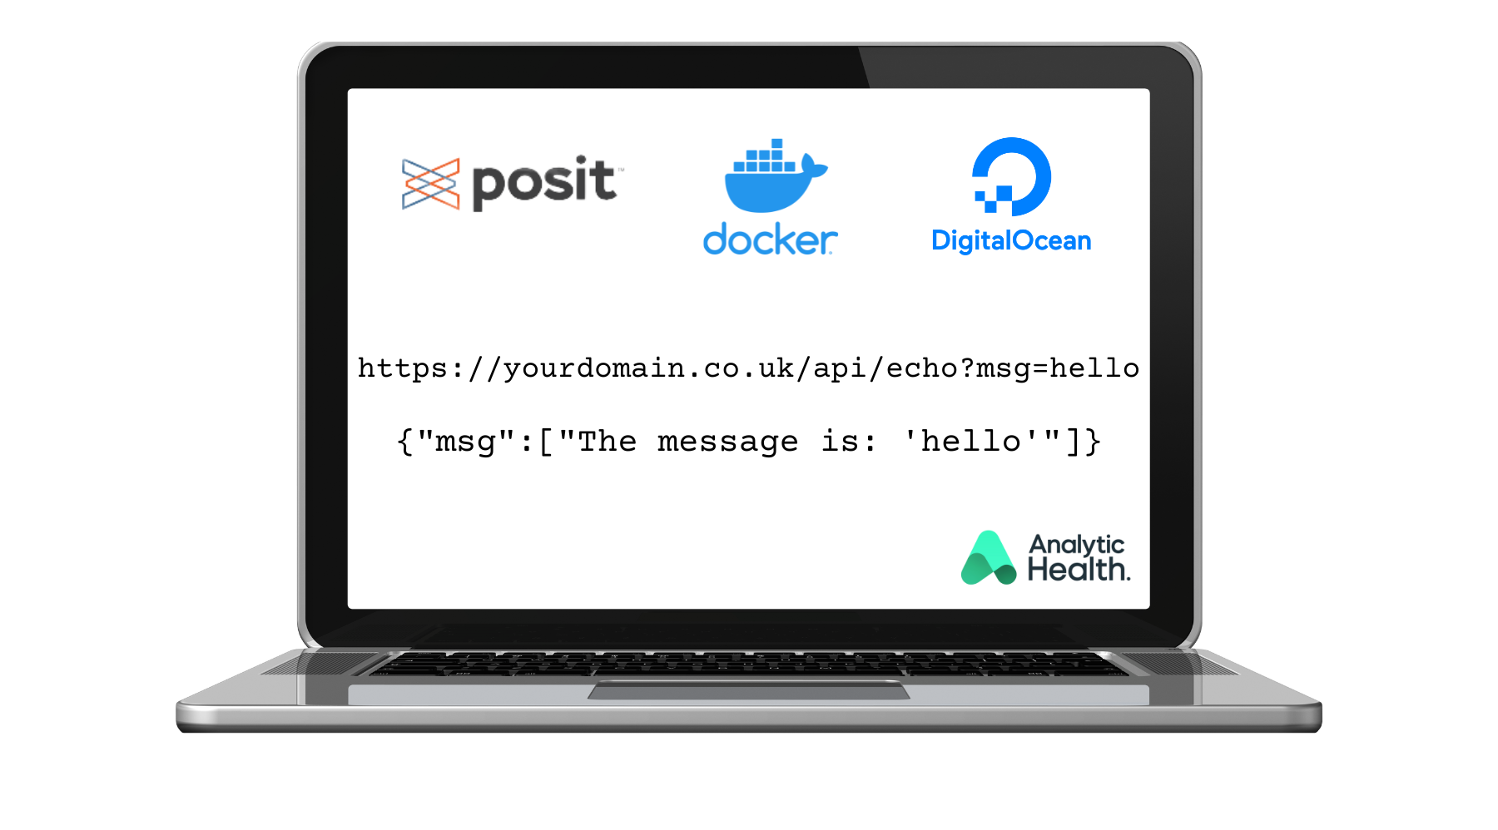
Veerle van Leemput – NHS-R Community Conference 2022 © Analytic Health 2022

Slide 15

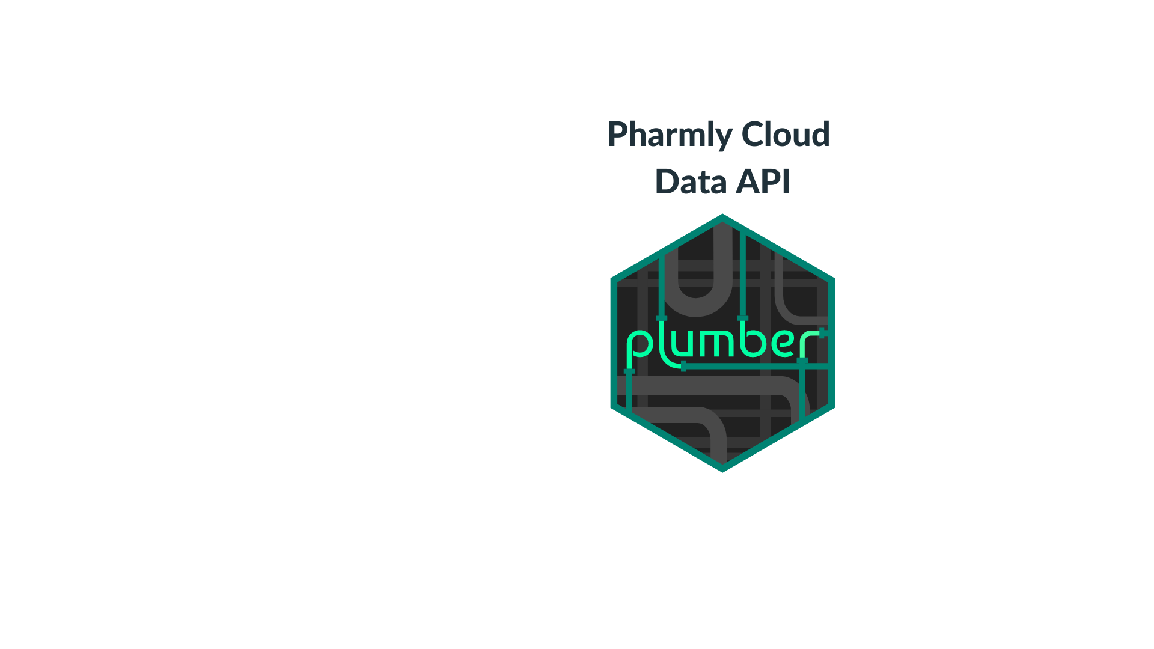
Veerle van Leemput – NHS-R Community Conference 2022 © Analytic Health 2022

Slide 16
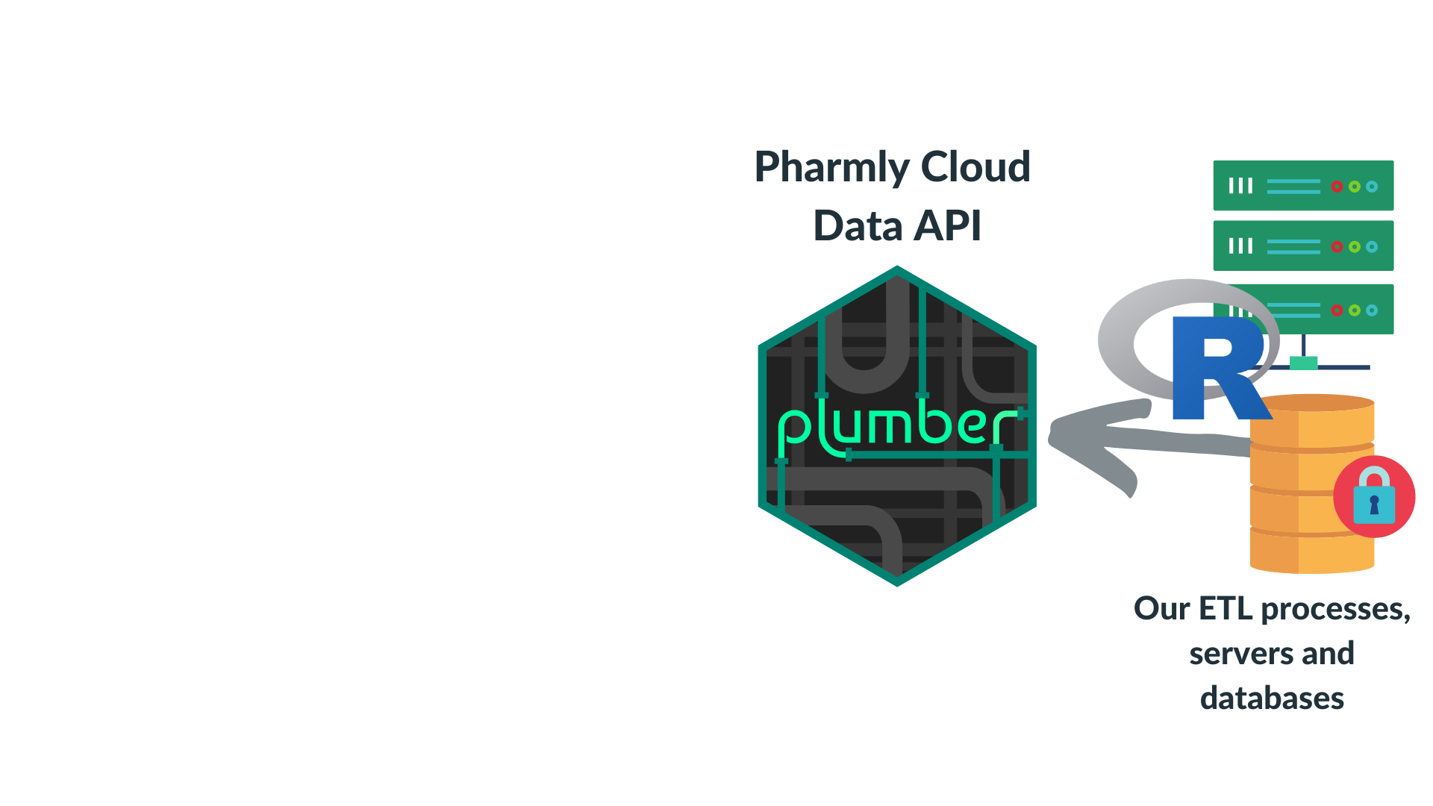
Veerle van Leemput – NHS-R Community Conference 2022 © Analytic Health 2022

Slide 17
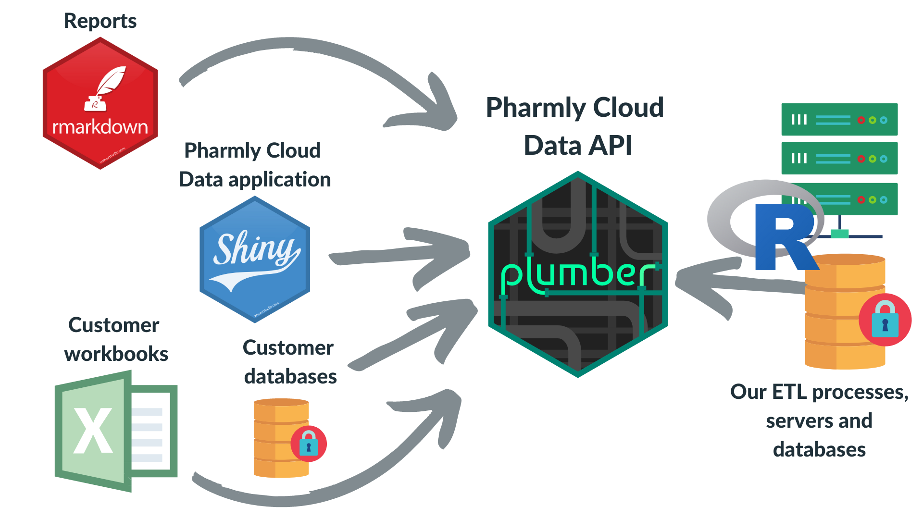
Veerle van Leemput – NHS-R Community Conference 2022 © Analytic Health 2022

Slide 18
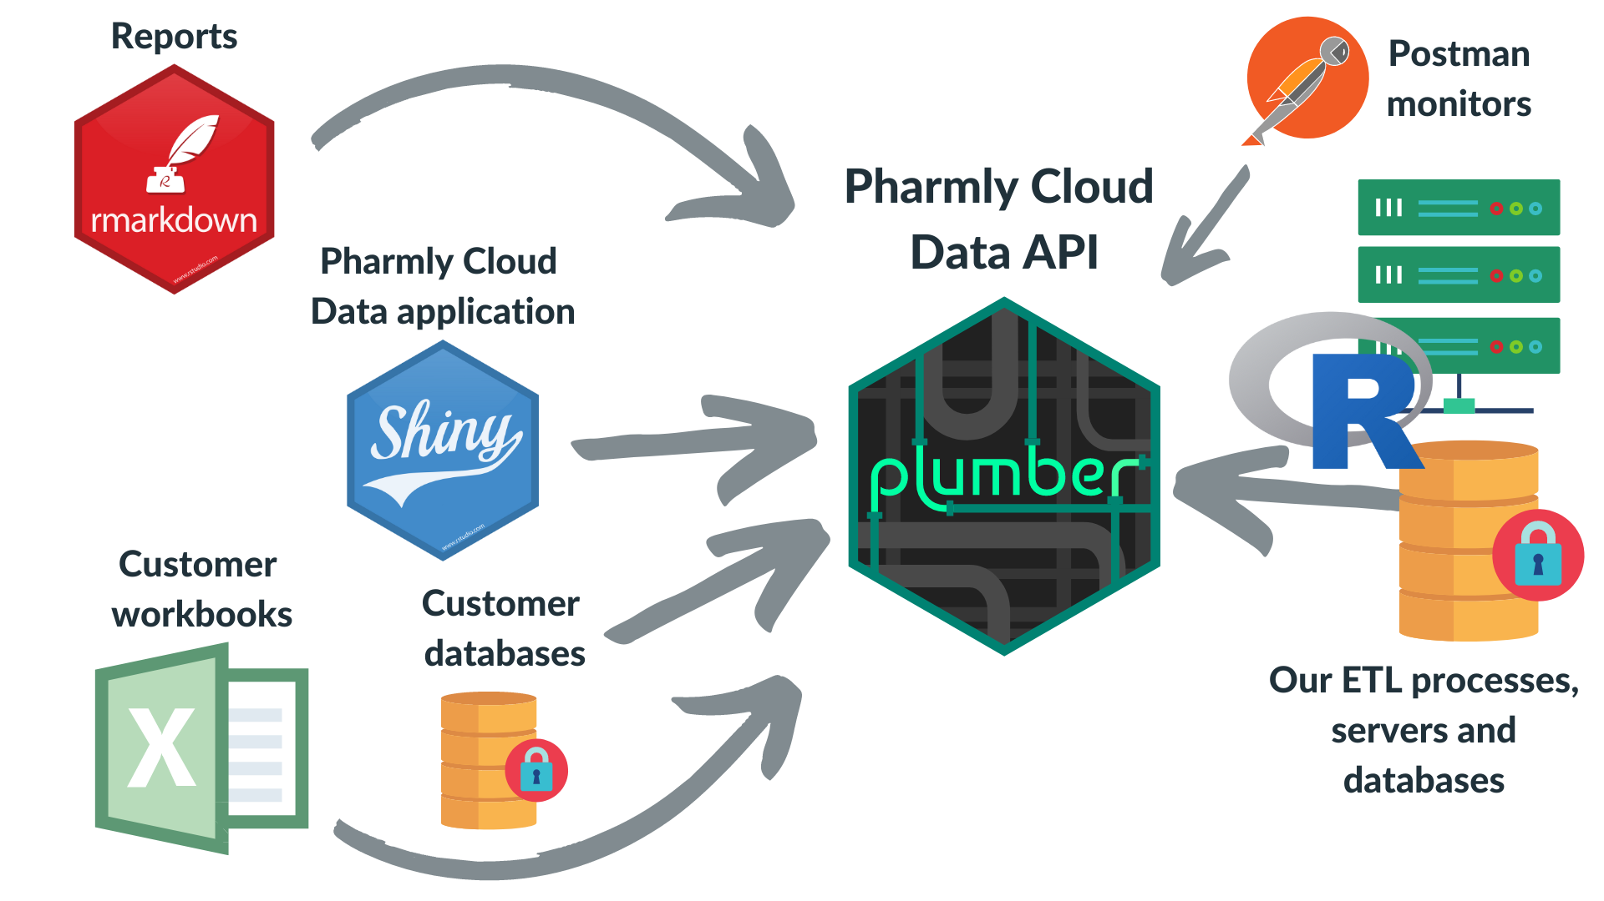
Veerle van Leemput – NHS-R Community Conference 2022 © Analytic Health 2022

Slide 19



Slide 20




Come find us at the lunch in an hour!
https://www.linkedin.com/in/veerlevanleemput/
https://analytichealth.co.uk
Veerle van Leemput – R in Production © Analytic Health 2021

